Slide 1
Working with JavaScript in SharePoint 2010
writing client-side code
Notes:
This lecture provides a quick review of the fundamental concepts of JavaScript programming including creating anonymous functions and creating JavaScript objects with object initialization syntax. There will also be a quick primer on using the DOM to access and manipulate elements on an HTML page. The heart of the lecture focuses on the reusable JavaScript libraries that are built-in to the SharePoint 2010 environment including ASP.NET AJAX and the SharePoint 2010 JavaScript Class Libraries. You will learn best practice programming techniques for registering client-side event handlers, executing AJAX requests across the network and using model dialogs to interact with users.

Slide 2
Agenda
JavaScript Programming Fundamentals
Writing JavaScript for SharePoint Pages
ASP.NET AJAX Libraries
SharePoint 2010 JavaScript Libraries

Slide 3
The Origins of JavaScript
JavaScript is now de facto language of browsers
Originally created for Netscape 2.0 in 1995
Standardized by ECMA for cross-browser support
ECMAScript is name of in language in the specification
Interesting JavaScript Trivia
"Java" added to name for marketing reasons
JavaScript has nothing in common with Java language
Microsoft prefers name 'ECMAScript' over 'JavaScript'

Slide 4
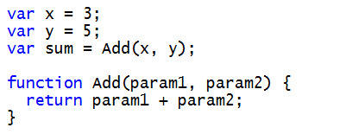
Getting Started
Language Fundamentals
JavaScript is case sensitive
Semicolons are optional but often used
Variables should be created using var keyword
How is JavaScript different from C# and OOP?
JavaScript is loosely typed
JavaScript is very relaxed about parameter passing
JavaScript supports dynamic objects but not classes

Slide 5
DEMO
Adding JavaScript code to a Web Page

Slide 6
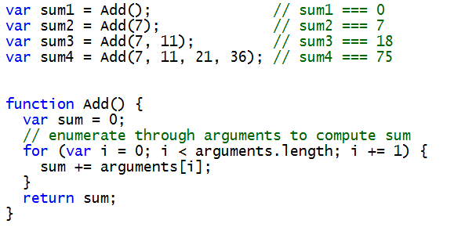
Function Parameters (aka Arguments)
Parameter are passed explicitly or implicitly
No error when caller's parameter list does not match
All parameters available through built-in arguments[]

Slide 7
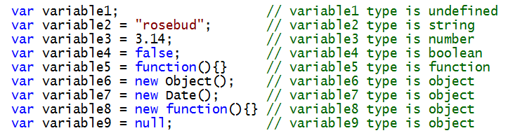
JavaScript Types
Each variable and parameter has a type
undefined
string
number
boolean
function
object
Variables and parameters inspected using typeof

Slide 8


Working with Arrays
JavaScript provides special initialization syntax
Array enumeration done using for loop
Array elements access using [] operator

Slide 9
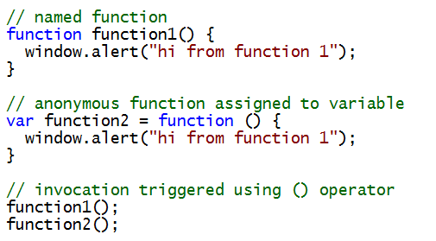
Functions are First Class Objects
Can take parameters
Return values

Slide 10
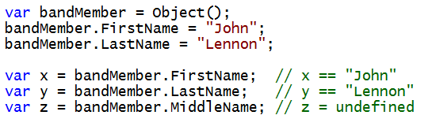
JavaScript Objects
An object is a collection of dynamic properties
Properties are name value pairs
Properties added on the fly (no need for class)
Uninitialized properties have value of undefined

Slide 11
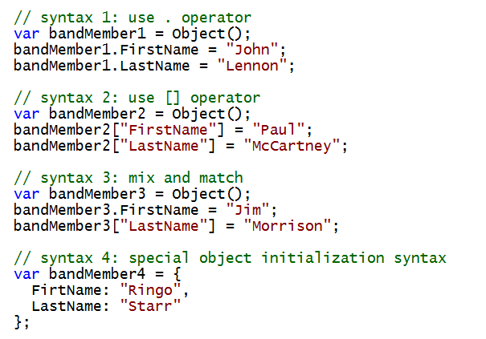
Initializing JavaScript Objects
There are several ways to initialize an object

Slide 12
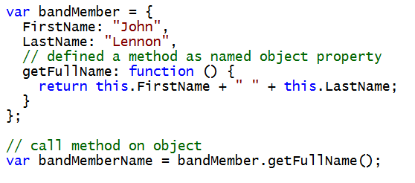
Adding a Method to an Object

Slide 13
Browser Objects
window
document
history
location
navigator
screen

Slide 14
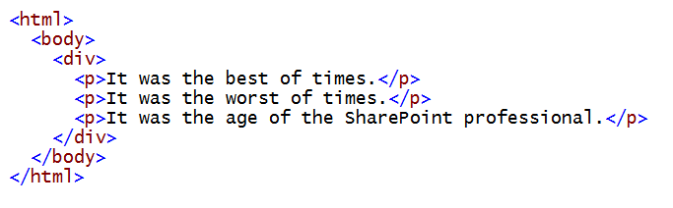
Document Object Model (DOM)
HTML elements constructed as tree
Tree nodes accessible through JavaScript code
html
body
div
p
p
p

Slide 15
The Document as a Node Tree
Accessor methods
getElementById
getElementsByTagName

Slide 16
DEMO
Accessing HTML Elements through the
Document Object Model (DOM)

Slide 17
Agenda
JavaScript Programming Fundamentals
Writing JavaScript for SharePoint Pages
ASP.NET AJAX Libraries
SharePoint 2010 JavaScript Libraries

Slide 18
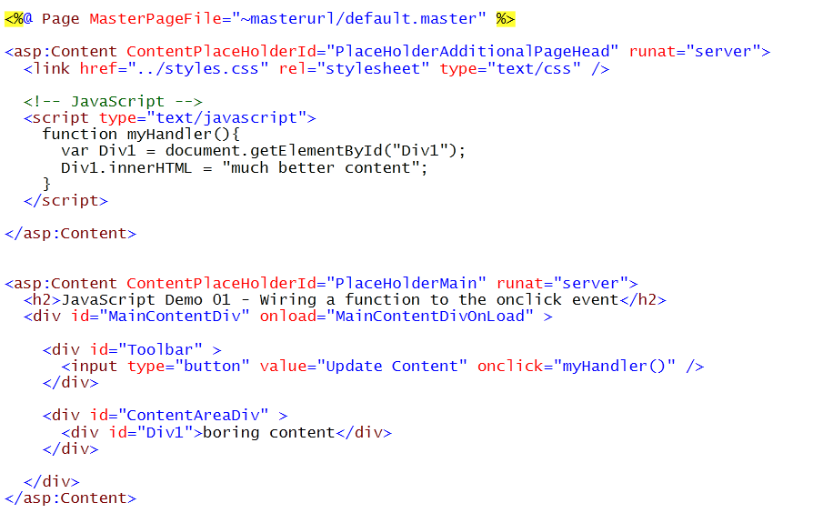
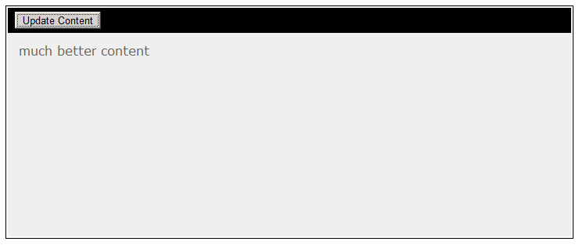
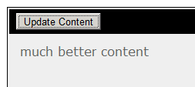
Adding JavaScript to a Site Page

Slide 19
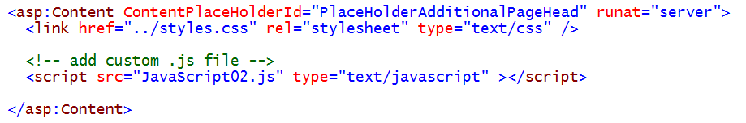
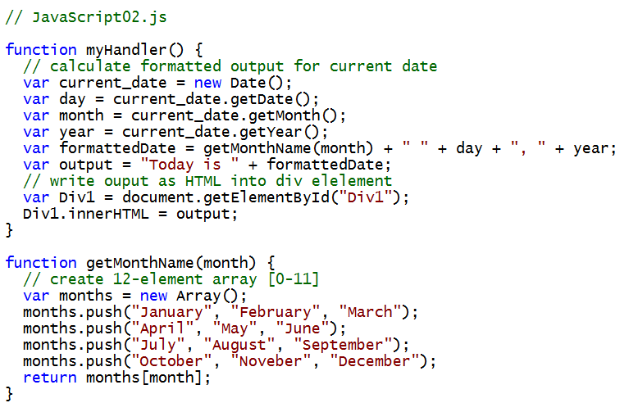
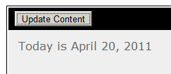
Moving JavaScript code into .js Files

Slide 20

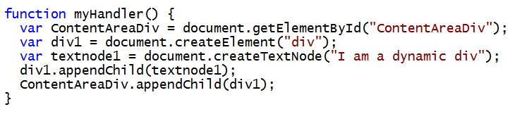

Dynamically Adding a DOM Element
Calls to create a dynamic element in DOM
document.createElement
document.createTextNode
appendChild

Slide 21
DEMO
Writing JavaScript Behind a SharePoint Page

Slide 22
Agenda
JavaScript Programming Fundamentals
Writing JavaScript for SharePoint Pages
ASP.NET AJAX Libraries
SharePoint 2010 JavaScript Libraries

Slide 23
ASP.NET AJAX 3.5
A library of JavaScript utility functions
Built into ASP.NET 3.5
Always available in SharePoint 2010

Slide 24
ASP.NET AJAX Namespaces
Global Namespace
Sys Namespace
Sys.Net Namespace
Sys.Serialization Namespace
Sys.Services Namespace
Sys.UI Namespace
Sys.WebForms Namespace

Slide 25
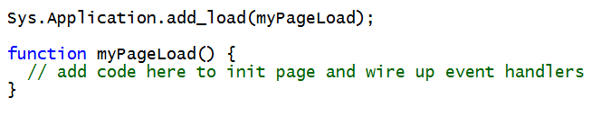
Sys.Application.load Event
Event which fires at end of document loading
Allows to program against DOM elements
Unlike window.onload, it does not wait for images
Often used to hook up event handlers

Slide 26
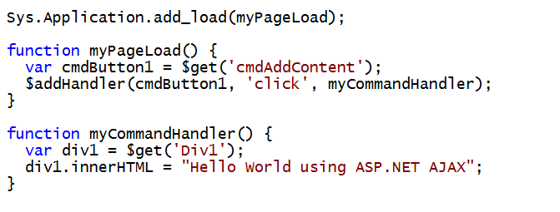
Common System.UI Functions
$get()
shortcut to the getElementById method
$addHandler()
shortcut to Sys.UI.DomEvent.addHandler method

Slide 27
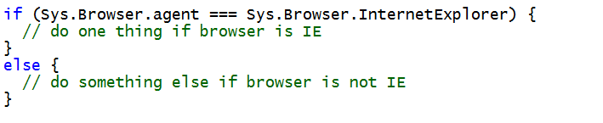
Sys.Browser

Slide 28
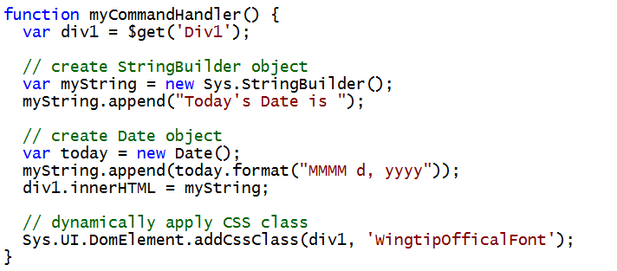
Using ASP.NET AJAX Utility Objects
StringBuilder object
Useful for concatenating strings
Date object
Useful for initializing and formatting dates
DomElement
Useful for modifying DOM elements

Slide 29
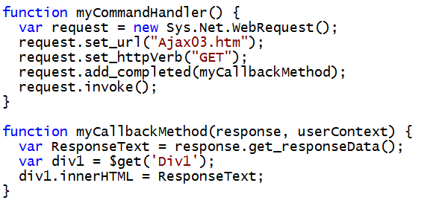
Using Sys.Net.WebRequest
WebRequest used to calls to Web server
Set target URL, HTTP verb type and callback method
Call invoke to make call across network
Handle return from Web server in callback method

Slide 30
Agenda
JavaScript Programming Fundamentals
Writing JavaScript for SharePoint Pages
ASP.NET AJAX Libraries
SharePoint 2010 JavaScript Libraries

Slide 31
SharePoint ECMAScript Class Library
SP Namespace
SP.ListOperation Namespace
SP.Ribbon Namespace
SP.Ribbon.PageState Namespace
SP.UI Namespace
SP.Utilities Namespace
SP.WebParts Namespace
SP.Workflow Namespace
CUI Namespace
CUI.Controls Namespace
CUI.Page Namespace

Slide 32
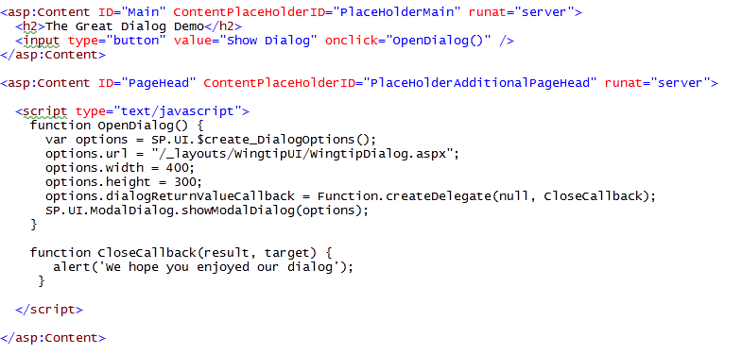
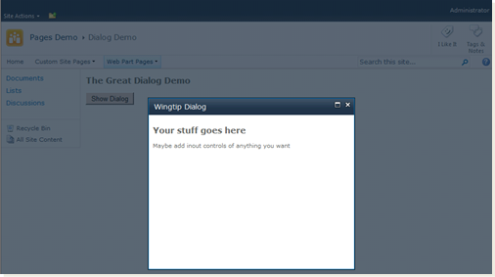
Dialogs
SP.UI.js contains API for creating modal dialogs
Notes:
In SharePoint 2007 whatever you wanted to do, you had to go through one or more pages. If you want to create a new item, you have navigate to the NewForm.aspx page to enter the data. After clicking the Save button you navigate back to the AllItems.aspx page.
One of the major changes in SharePoint 2010 is the display of dialogs to stay in the current context. If you want to create a new item, a dialog opens where you can enter your data. You can still see the AllItems.aspx page through the background. When you click the Save button, the dialog closes and the AllItems.aspx page is refreshed.
You can create your own dialogs by making use of the Dialog framework API that is defined in the SP.UI.js JavaScript file. The dialog itself is a normal SharePoint application page that implements 2 JavaScript methods: OpenDialog and CloseCallback.

Slide 33
DEMO
Writing JavaScript using ASP.NET AJAX

Slide 34
Agenda
JavaScript Programming Fundamentals
Writing JavaScript for SharePoint Pages
ASP.NET AJAX Libraries
SharePoint 2010 JavaScript Libraries

